Slide 1

AUTOMATED LOCATION BASED TIME AND ATTENDANCE TRACKING SYSTEM

Slide 2


HELLO !
Mentor : MR JOVIN KAMALA
I am Robinson E. Anthony

Slide 3
TABLE OF CONTENT
Introduction
Introduction to Bluetooth
Related Works
Proposed System
Data Collection
Data Analysis
SDLC Model
3

Slide 4

INTRODUCTION
The current system is manual attendance system
Where the use of sheet of paper is more preferred
4

Slide 5

INTRODUCTION TO BLUETOOTH
Bluetooth started as a short-distance cable-replacement technology to replace wires
5

Slide 6


INTRODUCTION TO BLUETOOTH …...
Bluetooth low energy (BLE) is a wireless computer network technology designed and marketed as Bluetooth Smart.
6

Slide 7

INTRODUCTION TO BLUETOOTH …...
Bluetooth Classic is a low power radio that streams data over 79 channels in the 2.4GHz unlicensed industrial, scientific, and medical (ISM) frequency band.
7

Slide 8
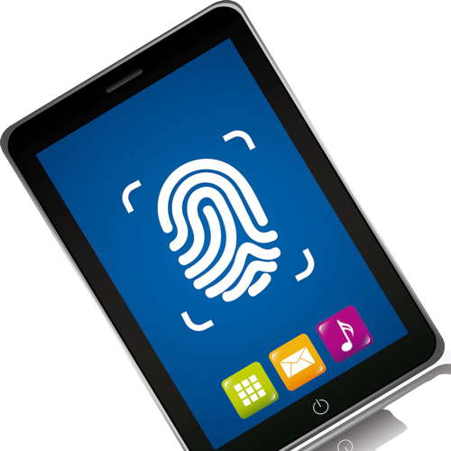
RELATED WORKS
Weaknesses
System Failure
It is Expensive
Flexibility
Not ideal for remote and field works
8

Slide 9
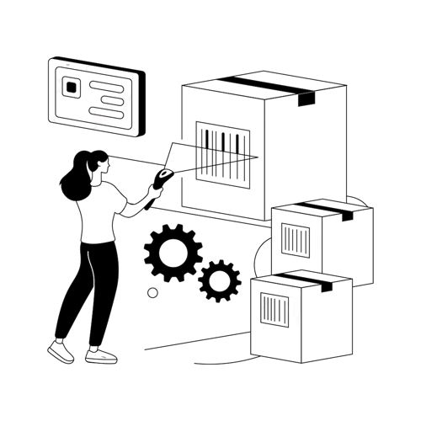
RELATED WORKS …...
Weaknesses
Cost
Range
Damages
Less Information
9

Slide 10

RELATED WORKS …...
Weaknesses
Image Quality
Storage
Biased Performance
Angles
10

Slide 11

PROPOSED SYSTEM
The System is based on the use of location of the student and time of different session in the process of tracking student’s attendance.
Features of Proposed System
Automated System
Mobile and Web Application
Use of Beacons For capturing attendance
11

Slide 12

PROPOSED SYSTEM…...
Strength of Proposed system
The system is full automated,
Easy in Installation of Mobile app for student,
An automated system reduces the risk of errors that are common in a manual system,
Allows the workforce to be more productive instead of wasting time on tedious administrative tasks.
12

Slide 13

DATA COLLECTION
Data collection is defined as the procedure of collecting, measuring and analyzing accurate insights for research using standard validated techniques.
13

Slide 14

DATA COLLECTION...
Observation is a data collection technique which entails use of senses to collect data from the internal environment.
14

Slide 15

DATA COLLECTION...
An interview is a face-to-face conversation between two individuals with the sole purpose of collecting relevant information to satisfy the proposed system
15

Slide 16
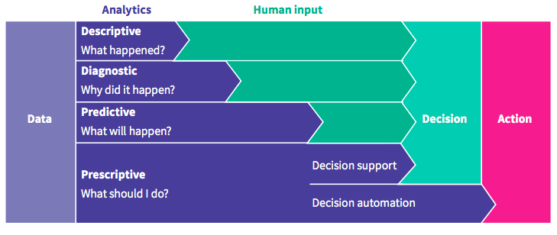
DATA COLLECTION...
Data analysis is defined as a process of cleaning, transforming, and modeling data to discover useful information for business decision-making.
15

Slide 17
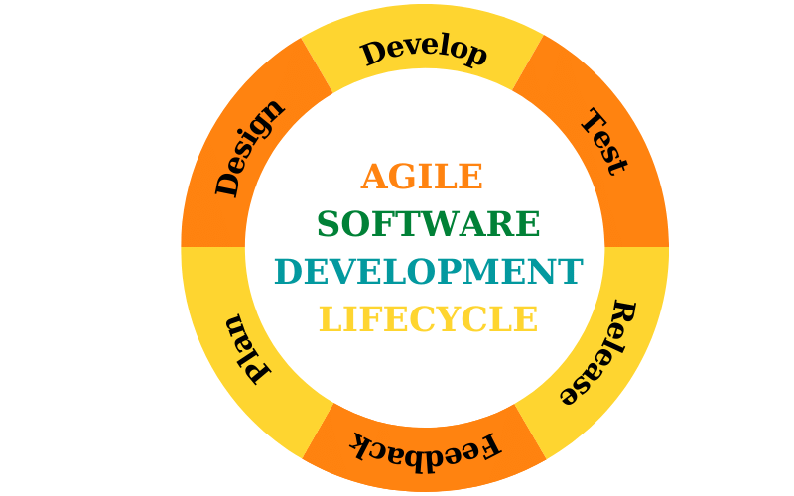
DATA COLLECTION...
Principles of AGILE Model
Customer Satisfaction
Welcome Change
Deliver Frequently
Face To Face
Working Software
16

Slide 18


Slide 19


